Slide 1
B17 Smart Controller
Dekie Cheng
July 2023

Slide 2
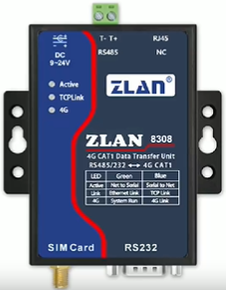


Physical Device Structure
172.1.1.1
WindowsAPP
172.1.1.2
172.1.1.3
FlexFlow DB
EPPS DB
172.1.1.n

Slide 3
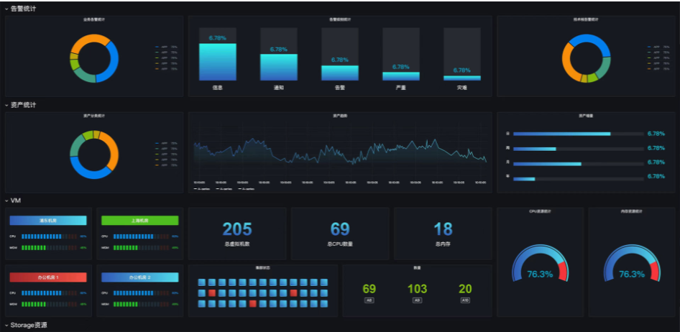
System Structure
RS485
Watermeter1
Watermeter2
水表
立方米
172.1.1.1
Watermeter3
RS485
….
Watermeter15
electricity meter1
电表KWh
总有功功率
正向有功总电能
合相功率因数
172.1.1.2
electricity meter2
electricity meter3
….
Display in Dashboard
RS485
electricity meter15
Air-conditioning chilled water flow meter1
空调冷冻水流量计 累积流量（Nm3）
瞬时流量(Nm3/h)
瞬时流速(m/s)
进水温度
出水温度
瞬时热量（GJ/h）
累积热量(GJ)
172.1.1.3
Air-conditioning chilled water flow meter2
….
Air-conditioning chilled water flow meter15
RS485
Windows Service
Compressed air flowmeter1
压缩空气流量计
累积流量（Nm3）
瞬时流量(Nm3/h)
瞬时流速(m/s)
172.1.1.n
Compressed air flowmeter2
SQL Server DB
This service will run on backend by specified interval time, and read the values from the physical device and store into DB tables
….
Compressed air flowmeter15

